Slide 1
Academic Approval
Tracking System
Casey T. Griffith
Assistant Director of Curriculum and Academic Policy Office of Undergraduate Affairs

Slide 2
Creating a New Professional Degree Program

Slide 3
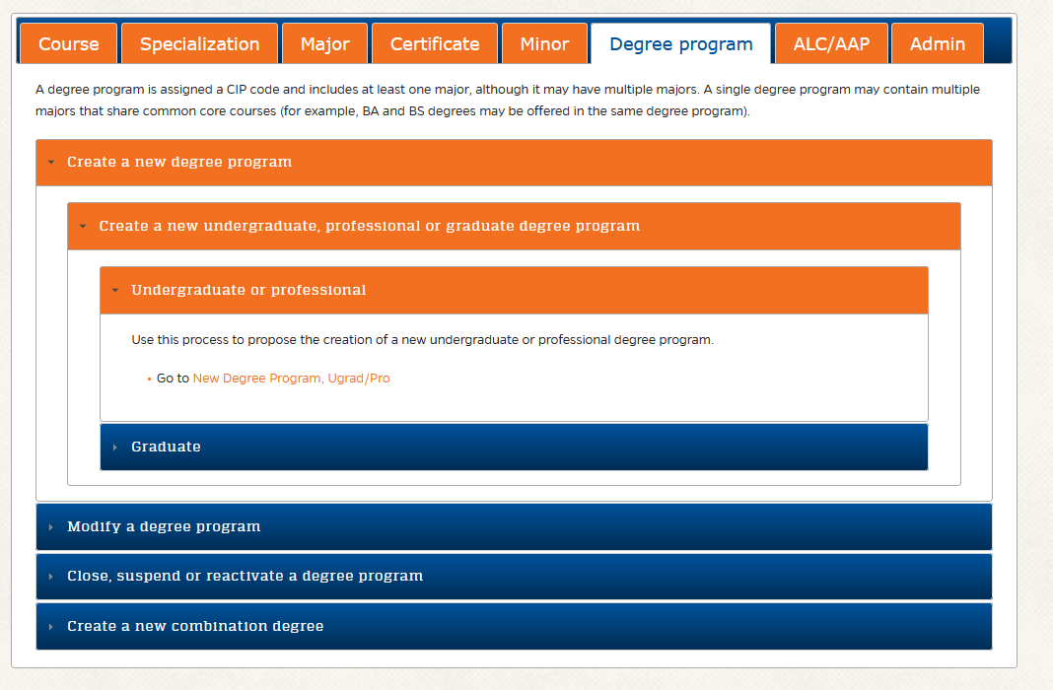
New Degree Requests
Where to Start:
Using the Approval System to submit a New Degree Request
https://approval.ufl.edu/start-new-request/

Slide 4
New Degree Requests
New Degree v. New Major
This process should be used to request a new degree program. This process may only be used if UF is not already approved to offer the same degree program level (e.g., Bachelor’s, Professional Doctorate) under the requested CIP code. If UF is already approved to offer the same degree program level under the requested CIP code, then the appropriate request may instead be a new major in an existing degree program, or a new track in an existing major. The proposed degree program must include at least one major but may have multiple majors.
IMPORTANT: All degree programs and majors must have associated Student Learning Outcomes.

Slide 5
New Degree Requests
New Degree, A Unique Process: Pre-Proposal
Pre-Proposal Process
Approval for any new degree program begins with the following pre-proposal process (also see the Process Flowchart). The pre-proposal process does not use the academic approval tracking system. The criteria for evaluation of new academic programs include: the program description; the assessment of need, demand and institutional priority; the planning process and timetable; the curriculum and articulation; and institutional resources.
Download and complete the Pre-Proposal form (.docx).
Vet the pre-proposal through the college using email (do not use the academic approval tracking system).
Submit the pre-proposal to the Provost's Office, Office of Undergraduate Affairs. The pre-proposal will be considered by the Provost's Office staff and the provost will make a final decision. If approved to go forward, the degree program will be included on the University’s Work Plan.

Slide 6
New Degree Requests
Proposal Process: An Extended Journey
Proposal Process Steps
Department (Approval is required from the Chair or other designated approver for the department that will offer the academic program, typically following review by the department curriculum committee.)
College (Approval is required from the Dean or other designated approver for the college or unit in the preceding step, typically following review by the college curriculum committee.)
OIPR (Approval of the CIP code is required by the Office of Institutional Planning and Research.)
APUG (Approval is required by the Associate Provost for Undergraduate Affairs.)
UCC (Approval is required from the University Curriculum Committee.)
FSSC (Approval is required from the Faculty Senate Steering Committee.)
Senate (Approval is required from the Faculty Senate.)
AA (Approval is required from Academic Affairs.)
BOT (Approval is required from the Board of Trustees.)
BOG (Approval is required from the Board of Governors.)
AA [N] (Academic Affairs is notified of the request.)
OUR (Approval is required from the Office of the University Registrar.)
OIPR [N] (The Office of Institutional Planning and Research is notified of the request.)
SASS (The change will be entered into the Student Academic Support System, effective in the term approved for the request.)
CAT (The change will be entered into the undergraduate catalog, effective in the term approved for the request.)
College [N] (The College is notified of request approval.)
*Highlighted steps will add on multiple months per step.
*Any new course requests related to the degree program must be approved prior to this submission.
*Doctoral level programs are only approved by the BOG twice a year, in June and November.

Slide 7
New Degree Requests
Required Documents
BOG/SUS Program Proposal Submission Form (.docx) - download, complete electronically, and save on your computer
New Degree Proposal Worksheets (.xlsx) - download, complete electronically, and save on your computer
Limited Access form (.pdf) if applicable - download, complete electronically, and save on your computer
Catalog copy - catalog-style description of the degree program, requirements for entry, requirements for completion, and a list of majors, minors, certificates, etc. (Word document preferred)
Supporting documentation
Include memos, emails, etc. from other units to provide evidence of the availability of courses that are required in the degree program and/or to provide evidence for support of the proposed program if there is clear or potential overlap or duplication of content.

Slide 8
New Degree Requests
Example of New Degree Request: Doctor of Athletic Training
Request link: https://secure.aa.ufl.edu/Approval/reports/12432
Submitted to Approval System: March 2018
Approved by UCC: April 2018
Approved by Faculty Senate Steering: May 2018
Approved by Faculty Senate: August 2018
Approved by BOT: September 2018
Approved by Board of Governors June 2019
Added to Student Academic Support System (Audits): April 2020
Final notifications: May 2020
https://approval.ufl.edu/start-new-request/

Slide 9
New Degree Requests
Example of New Degree Request: Doctor of Occupational Therapy
Request link: https://secure.aa.ufl.edu/Approval/reports/11297
Submitted to Approval System: November 2016
Approved by UCC: December 2016
Approved by Faculty Senate Steering: January 2017
Approved by Faculty Senate: February 2017
Approved by BOT: March 2017
Approved by Board of Governors: July 2017
Added to Student Academic Support System (Audits): October 2017
Final notifications: January 2018
https://approval.ufl.edu/start-new-request/

